Slide 1



Vishnu Overseas
COMPANY PROFILE
Company Name : VISHNU OVERSEAS
Address : PLOT NO. E-125, Rameshwar Nagar, Basni, 1 Phase County / Town : INDIA / JODHPUR
CONTACT NO : 91-80038-90290
E mail : overseasvishnu@gmail.com OWNER : Mrs. Vijay laxmi Jangid
PRODUCTION STAFF : WOODEN – 40, IRON - 25 (VARIABLE) POLISHING STAFF : 20 PEOPLE (VARIABLE)
PACKAGING STAFF : 6 PEOPLE (VARIABLE) SUPERVISOR FOR QC : 3 + QC MANAGER
SUPPLIER / SUBCONTRACTOR : 8 (4 FOR WOOD & 4 FOR IRON)

Slide 2
A brief description about company, year established, volume, main markets, customer base, capacity:
V ISHNU OVERSEAS is a leading manufacturer and exporter of Indian furniture. To have furniture from us is like having a little bit of India in your home. Company specializes in manufacturing different types of furniture and other products like:-
S olid Wood Furniture (Bedroom , Living room, Dining room furniture) (Out door )
I ndustrial Furniture ( Iron /Metal)
A ccent Tables
R ecycled Wood Furniture
D ecorative, Gifts and Accessories
W e offer every year new designs to compete the market,
Our company Established in 1980 , Jodhpur in the western Indian state of Rajasthan is considered to be the home of Indian furniture and we embody the traditional Rajasthani craftsmanship while making our furniture. The skills are passed down through generations and today we are a renowned name in the world of wooden furniture and handicrafts.
Currently we have production of 800-1000 CBM, and 80% export to European countries and USA, and 20% domestic supply to other Exporters, our strength is our skilled Man power we can expand it according to demand, we are able to produce 2000 CBM in continue orders,
Our Main market are The Netherland, Germany, Belgium, Canada, USA. UK and Australia.

Slide 3
General Manager Info and Photo:
Name: Mr. Vishnu Jangid
Title: General/Export Manager
Personal Mobile: 91-80038-90290
Contact E-mail: vishnuss007@.com
Direct line:

Slide 4
Additional Contact Info and Photo:
Name: Mrs. Vijay laxmi Jangid
Title: OWNER
Personal Mobile: 91-72969-98778
Contact E-mail:
Direct line: 0291-

Slide 5
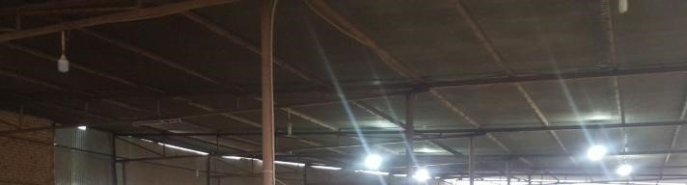

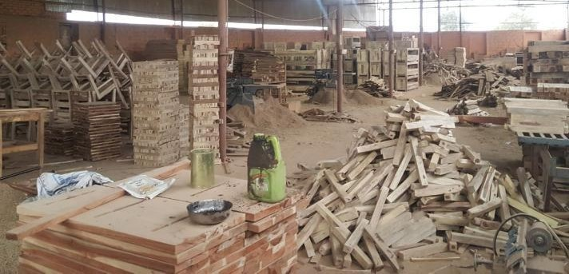
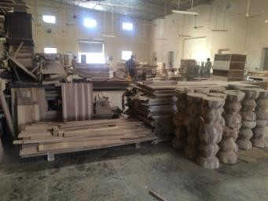
Factory production area photos

Slide 6
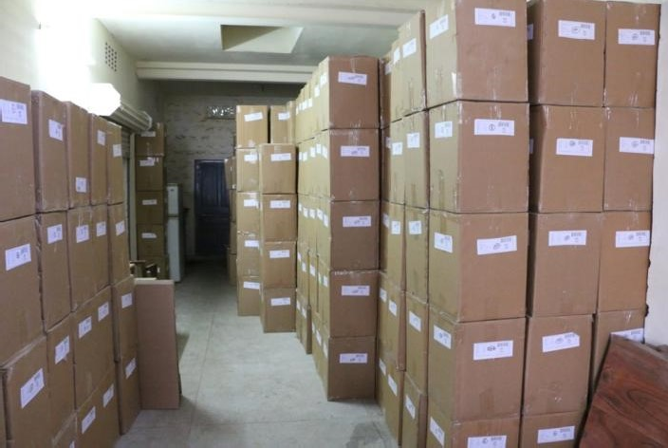
warehouse shipping area photos

Slide 7
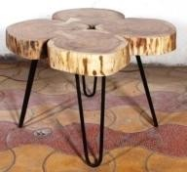
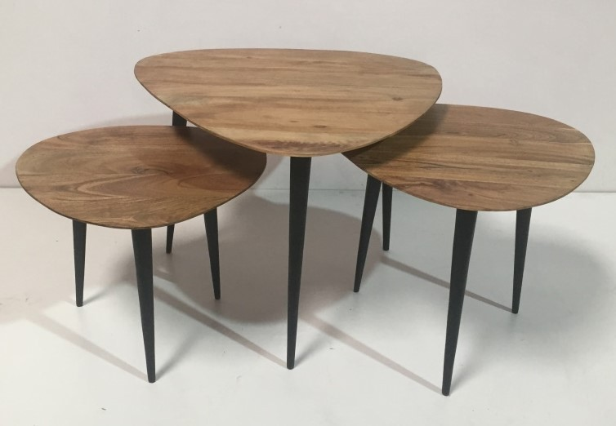
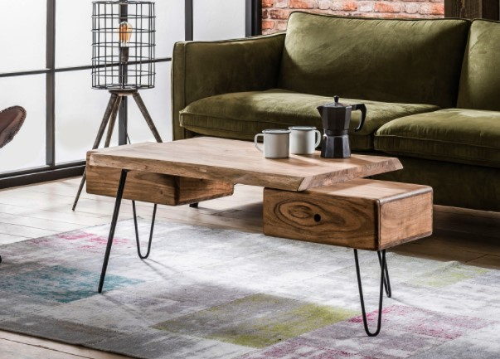
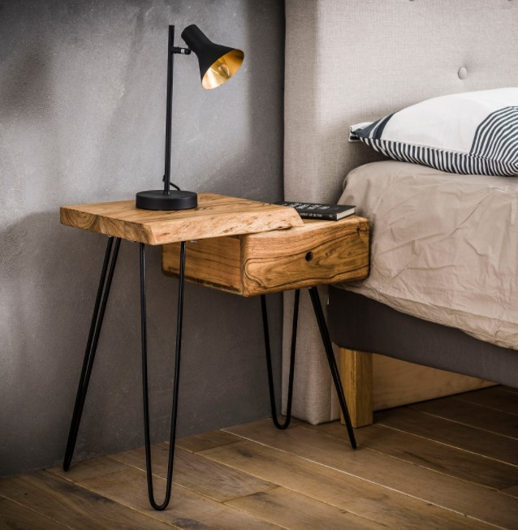
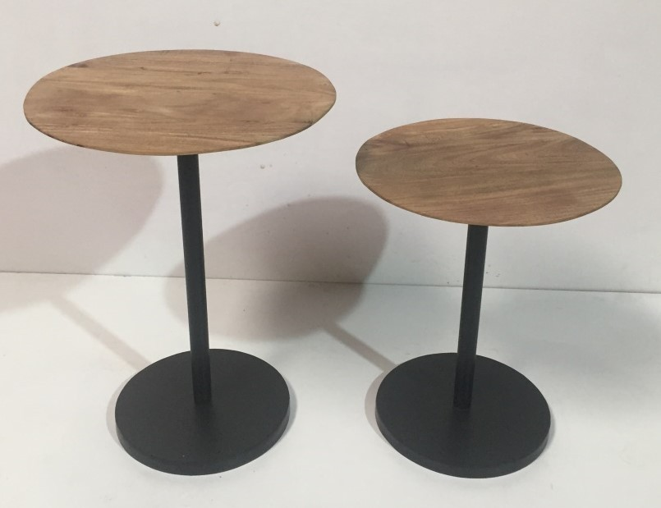
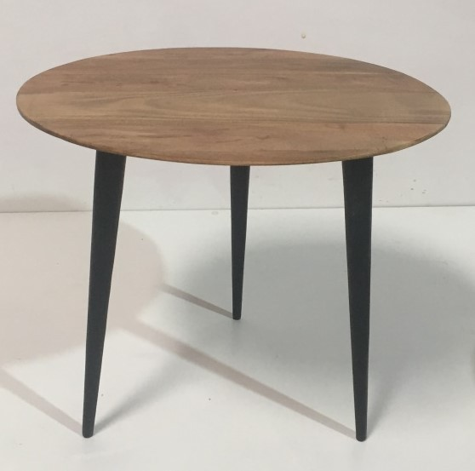
Some photos of Current Production

Slide 8
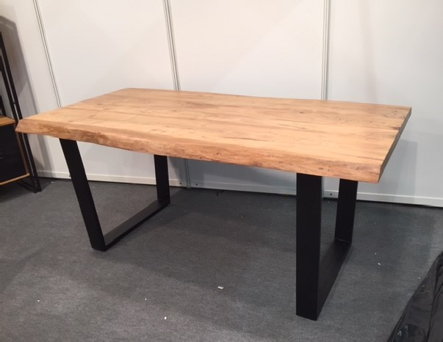
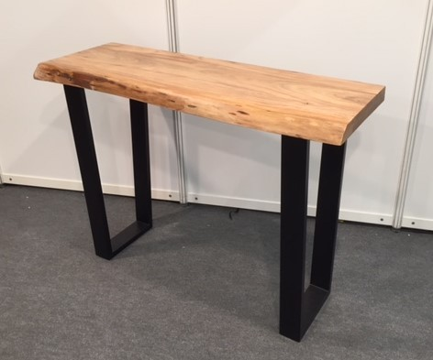
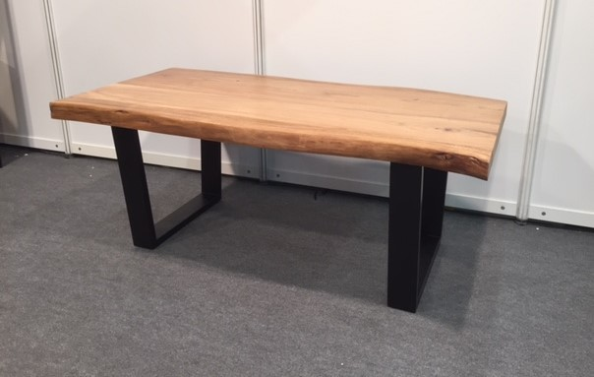
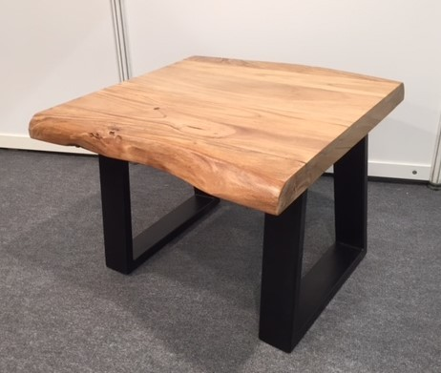
Some photos of Current Production

Slide 9
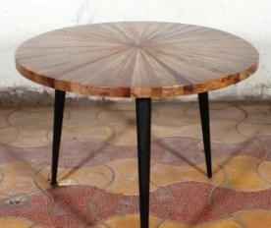
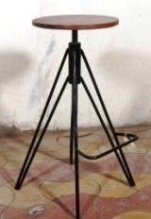
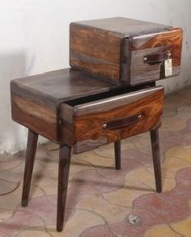

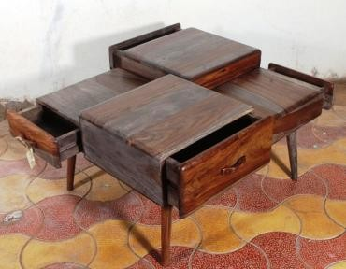
More photos for consideration

Slide 10


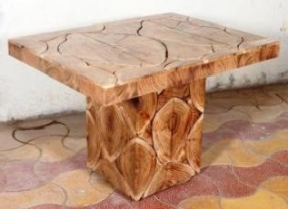
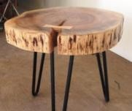



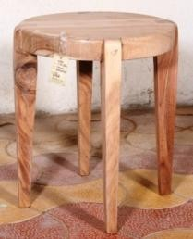
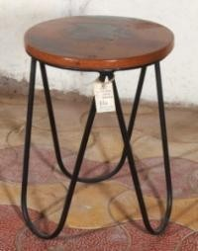
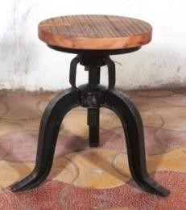

More photos for consideration

Slide 11


Vishnu Overseas
Vishnu Overseas
E-125, Rameshwar Nagar
Basni 1st phase, Jodhpur 342005
Contact No: +91-80038-90290
email: overseasvishnu@gmail.com
Thank You

